Slide 1
Team Alpha Super Awesome Cool Dynamite Wolf Squadron
Or the Zoo Team for Short

Slide 2





Members
Francisco Salazar- Team Leader
Yamile Perez- Scale Artist
Edwin Sanchez- Revisions Supervisor
Crystal Torres- Research Analyst

Slide 3
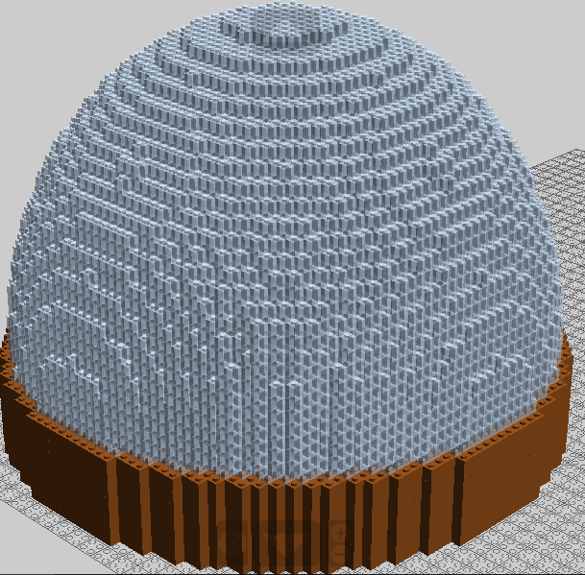
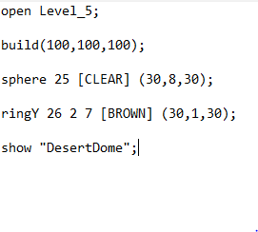
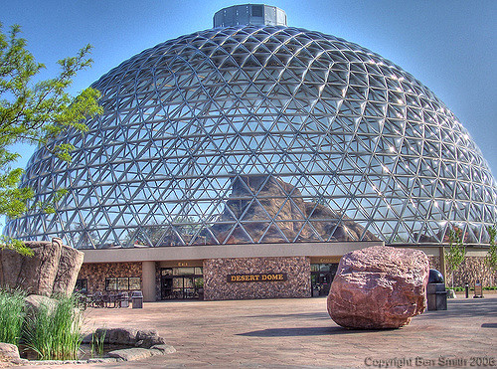
Current Progress
The Dome is mostly built along with its base.

Slide 4


Thought Process & Obstacles
We have a good team dynamic throwing ideas around and listening to each other.
We elaborate on each others thoughts and separate the work evenly among each other.
The only obstacle we have faced is the slow computer problems and the slow rendering process

Slide 5
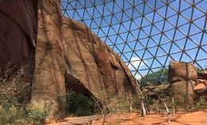
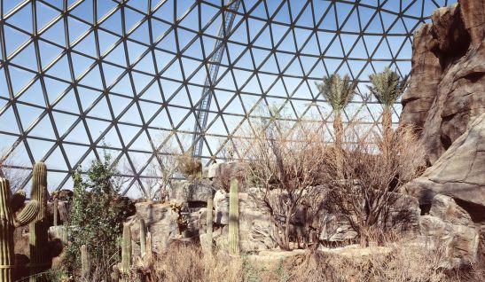
Next Steps
Design and finalize a sketch for the interior of the Desert
Begin coding the inside and finish that up

Slide 6
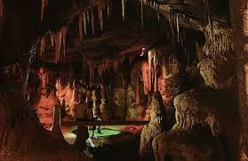
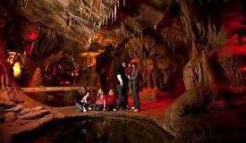
Future
If time allows, design and finalize a sketch for the Kingdom of the Night
Code as much as we can of that too.

Slide 7


